Slide 1
Paging, Filtering and Sorting
Ishaan Malik

Slide 2
Paging, Filtering and Sorting
Filtering keeps only the rows that match (for example, only Category = "Phones").
Sorting puts the rows in an order (for example, cheapest first).
Paging returns the rows in chunks (pages), so the client doesn't download everything at once.
Implementing paging, filtering, and sorting ensures your endpoints stay fast, scalable, and secure.

Slide 3
Paging
Paging is the process of splitting a large dataset into smaller, manageable chunks (pages) before sending it across the network.
Without paging, an API trying to return millions of database rows will crash the server, exhaust network bandwidth, and freeze the client application.

Slide 4
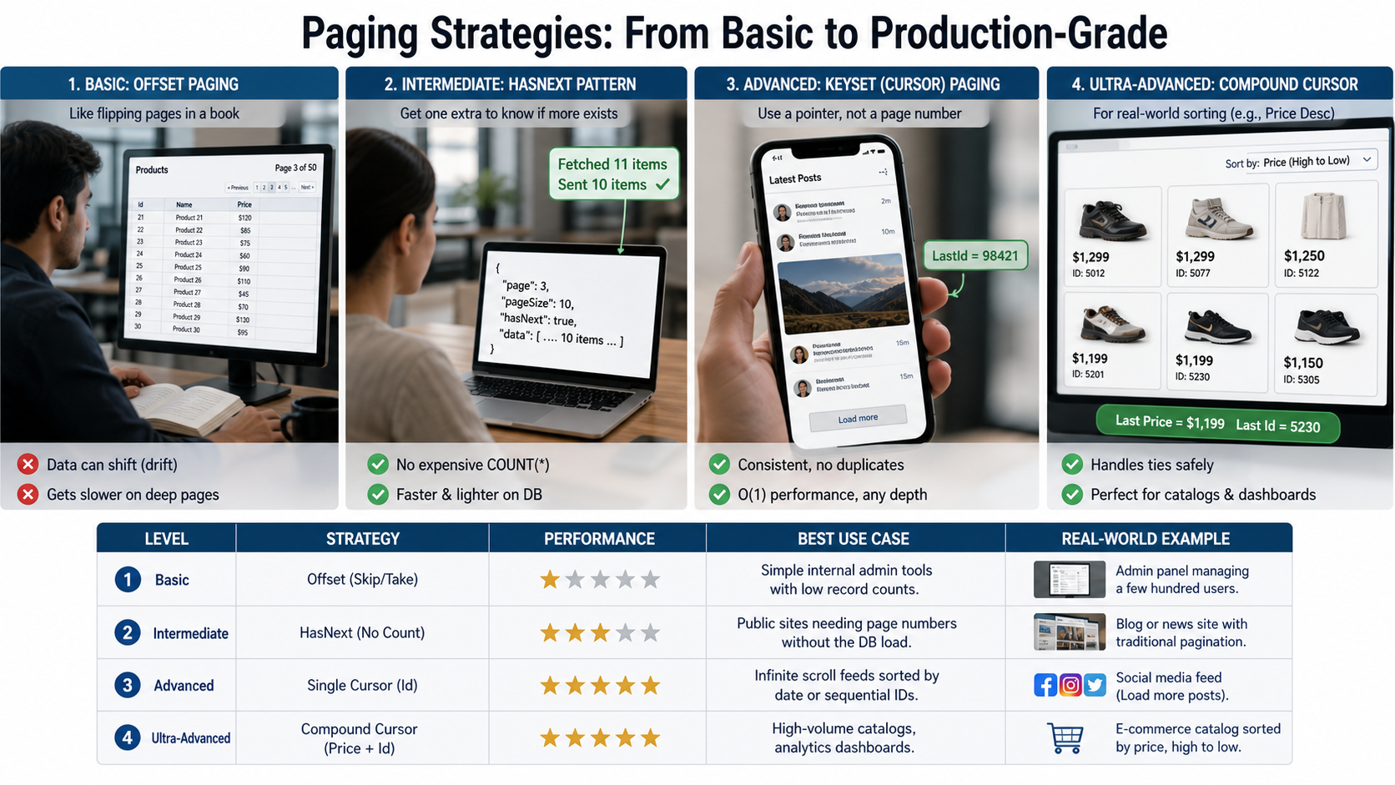

Slide 5
Filtering
Filtering is the process of restricting which database records are returned based on user-defined criteria.
Without filtering, clients are forced to download massive datasets and waste processing power discarding unwanted rows on the front end.

Slide 6
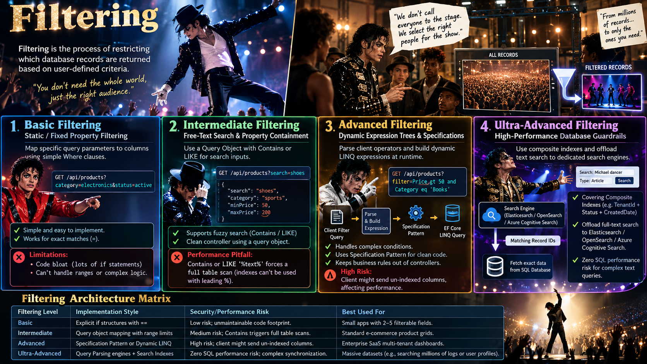

Slide 7
Sorting
Sorting is the process of arranging API response data in a specific order, such as chronological, alphabetical, or numerical.
Proper sorting occurs entirely within the database engine, ensuring that data is organized before it is loaded into memory or transmitted across the network.

Slide 8
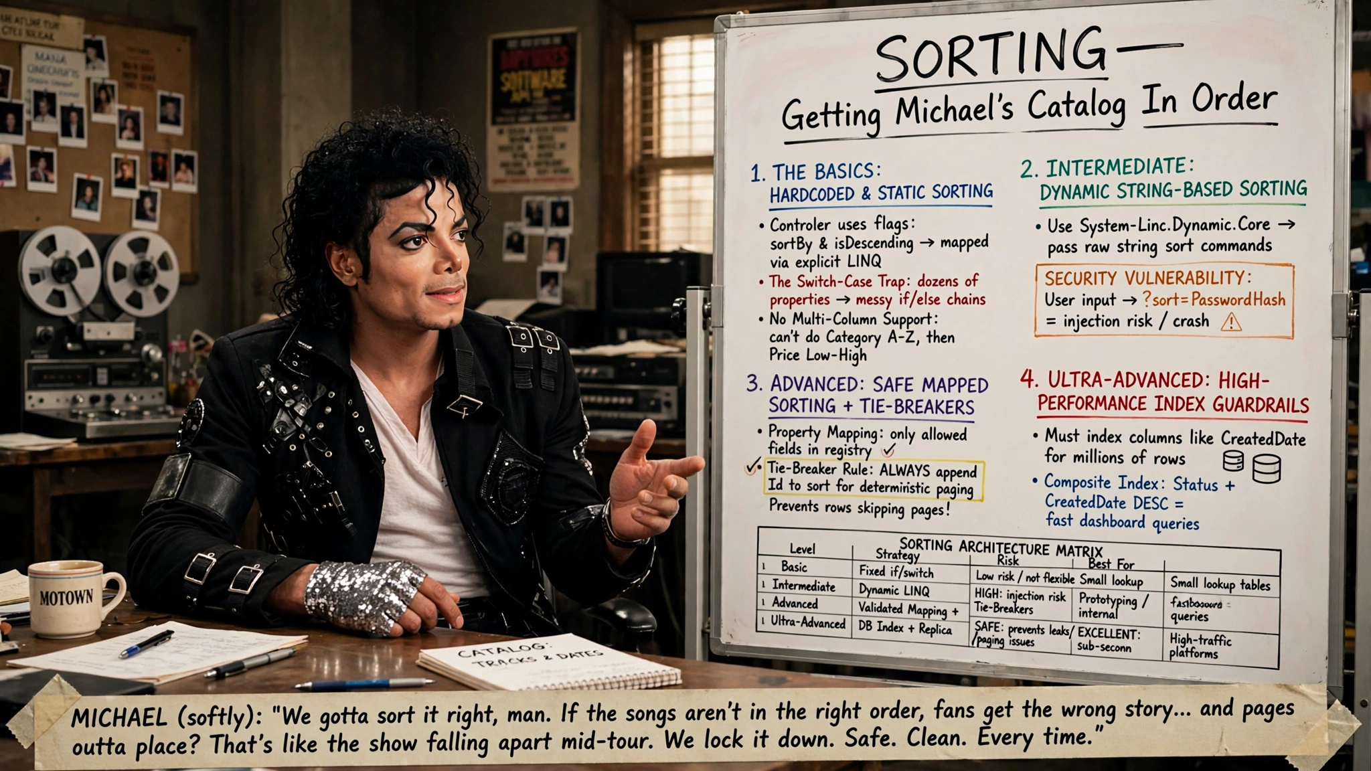

Slide 9
Quick Quiz
Why can using traditional Skip() and Take() methods for deep paging (e.g., skipping 100,000 records) lead to performance degradation in a database-backed Web API?
The database still evaluates and reads the skipped rows from disk or memory buffers before discarding them.
The Web API server runs out of memory because it caches all skipped pages internally.
Skip() forces the database management system to apply an exclusive write lock on the entire table.
Skip() executes an O(1) memory pointer jump directly to the target row offset in the database.
Answer: A

Slide 10
Quick Quiz
When implementing sorting and pagination on a dataset where multiple records share the same value in the primary sort column (e.g., sorting by LastName which is not unique), why is adding a secondary tie-breaker sort column (like Id) critical?
It prevents SQL injection vulnerabilities when sorting user-supplied string parameters.
It ensures a deterministic and stable row order across page requests, preventing duplicate or skipped records.
It forces the database engine to automatically create a clustered index on the primary sort column.
It completely disables the primary key index to optimize sorting speeds for large results.
Answer: B

Slide 11
Quick Quiz
In an ASP.NET Core Web API using Entity Framework Core, what is the primary architectural advantage of returning or working with IQueryable<T> instead of IEnumerable<T> when applying dynamic filtering, sorting, and paging?
IEnumerable translates filter, sort, and paging expressions into a single optimized database SQL command.
IQueryable fetches all database records into memory immediately upon initialization before filtering.
IQueryable enables composition of LINQ queries so that filters, sorting, and paging are combined and executed remotely on the database server.
There is no performance or query generation difference between IQueryable and IEnumerable in API controllers.
Answer: C

Slide 12
Quick Quiz
What is the primary benefit of Keyset (Cursor-based) paging over traditional Offset-based paging (Skip/Take) in large datasets?
It allows the client to jump instantly to an arbitrary page number, such as page 50,000.
It works entirely without requiring any database indexes or unique ordering columns.
It requires significantly less C# syntax and fewer LINQ operators to implement in a controller.
It maintains consistent and fast query performance regardless of how deep the user navigates into the dataset.
Answer: D

Slide 13
Q&A
The End

